Slide 1
Intelligent Mobile Bus Ticketing System
Supervised by
Dr. Ahmed Shawki Moussa
TA. Mahmoud Mohsen
Implemented by
Student Id | Student Name
20140192 | Amr Saeed Hosny
20140064 | Ashrakat Mokhtar
20140187 | Omar Fawzi Salama
20140196 | Amr Magdy Ibrahim

Slide 2

Project Idea
Developing a payment method for means of transportation based on cellphones. The passenger downloads an application on his cellphone and creates an account on it. The passenger’s account could be charged with balance then his/her phone could be passed over a reader on several types of public transportation to deduct the fare.
The system is an application belonging to the realm of Internet of Things (IoT).

Slide 3
Problem Significance
Problems Targeted
Driver distraction
Arrival delay
Slow process of ticketing
Non trackable transactions
Tickets production costs
Change problems
Ticket loss

Slide 4
Problem Significance
Why and How to Solve It
Why?
  Safety of passengers
  Increase transactions speed
  Reduce arrival delay
How?
  Utilize a single compact device
  Easier usage more flexibility

Slide 5
Problem Significance
Previous Solutions
1. Existence of driver assistant
  Advantages:
    Less distraction on the driver
    Arrival delay is minimized
  Disadvantages:
    Low reliability and efficiency
    Other subproblems aren’t solved yet

Slide 6
Problem Significance
Previous Solutions
2. Rechargeable and non-rechargeable transportation cards
  Advantages:
    Saves time and effort
  Disadvantages:
    Several cards distracts the holder
    Hard to track
    Still subproblems targeted aren’t solved yet

Slide 7
Problem Significance
Our Digital Solution
  Advantages:
    No distraction on the driver
    No arrival delay
    No change problem
    No payment delay
    Saving ticket production

Slide 8
System analysis and Design
System Architecture
The system architecture used with imobuts is the well-known MVC architecture. The reasons for using it is the need of having a single back-end with multiple frond-end devices that depends on that back-end.

Slide 9
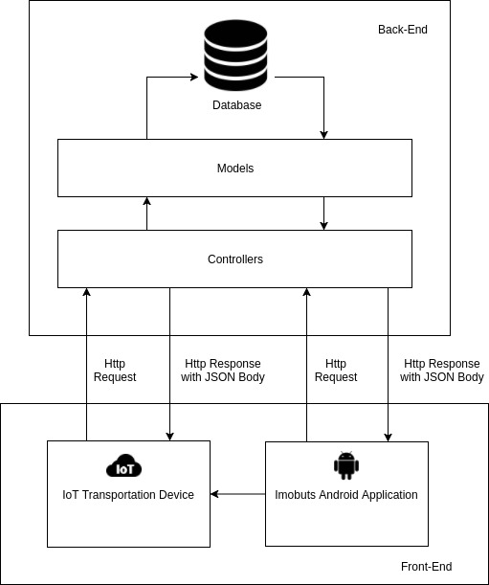
System
Architecture

Slide 10
System analysis and Design
Stakeholders
Passenger (Main user)
Vehicle driver
System owner
Transportation policy makers

Slide 11
System analysis and Design
Functional Requirements
Sign up
Sign in
Logout
Forget password
View profile
Edit profile
Charge
View tickets
View ticket details
Issue ticket

Slide 12
System analysis and Design
Non-Functional Requirements
Security
Usability
Performance
  Response time
  Accuracy
Reliability
Robustness

Slide 13
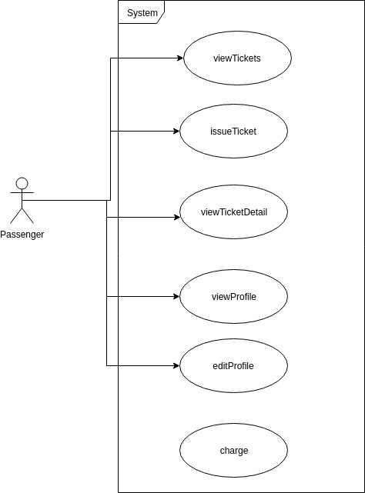
Usecase Diagram

Slide 14
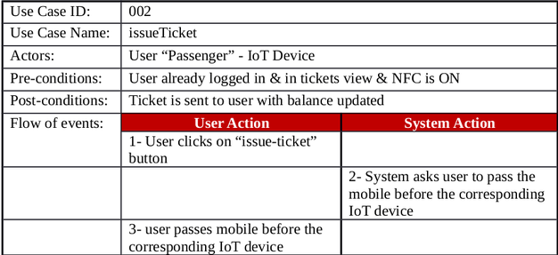
System analysis and Design
Use Case Tables
1. issueTicket:

Slide 15
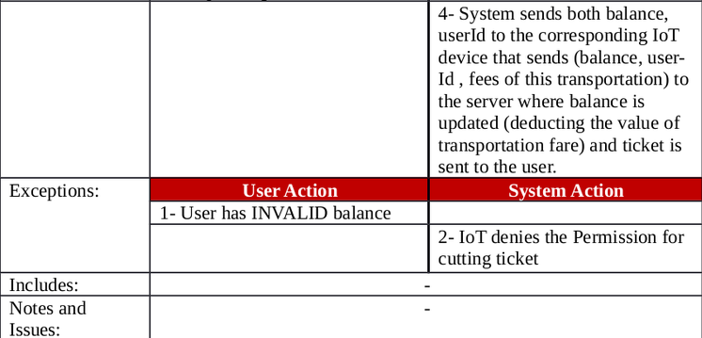
System analysis and Design
Use Case Tables
1. issueTicket:

Slide 16
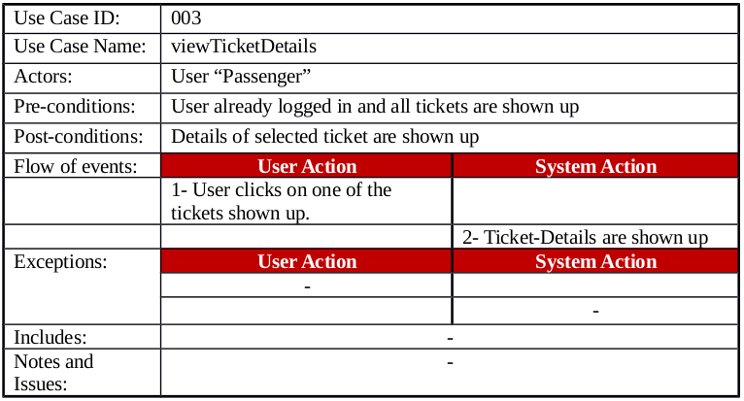
System analysis and Design
Use Case Tables
2. viewTicketDetails:

Slide 17
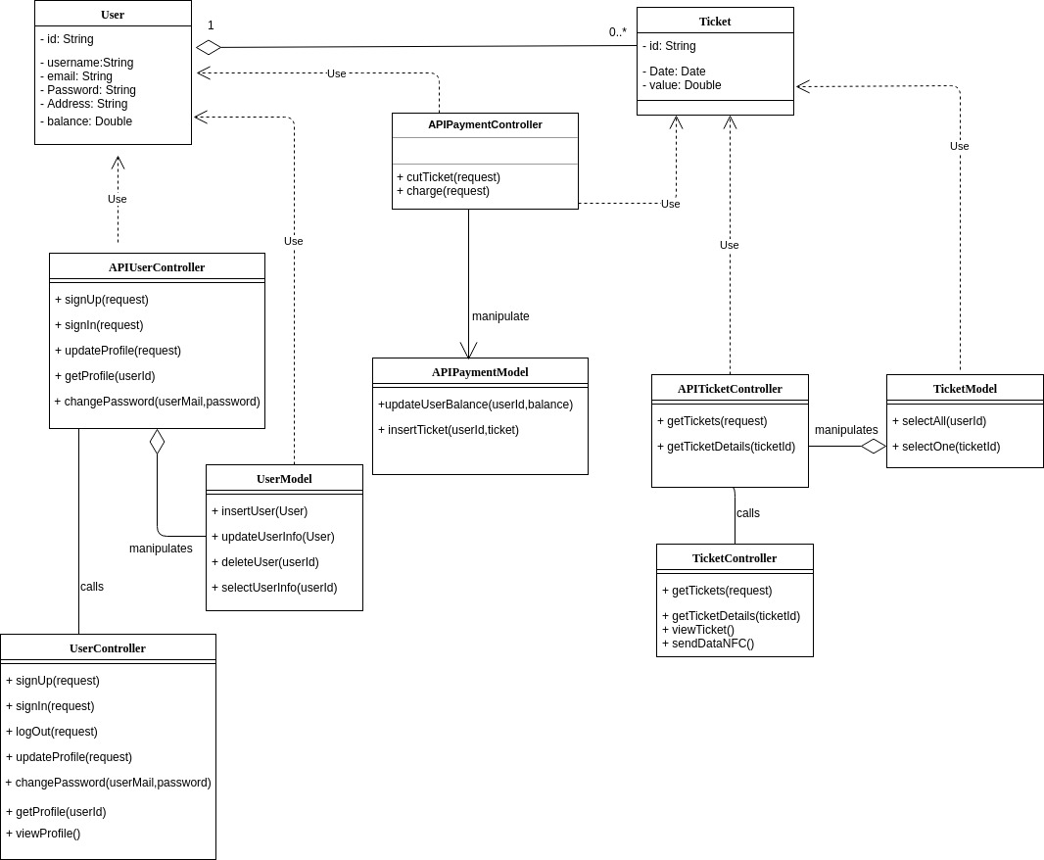
Class
Diagram

Slide 18
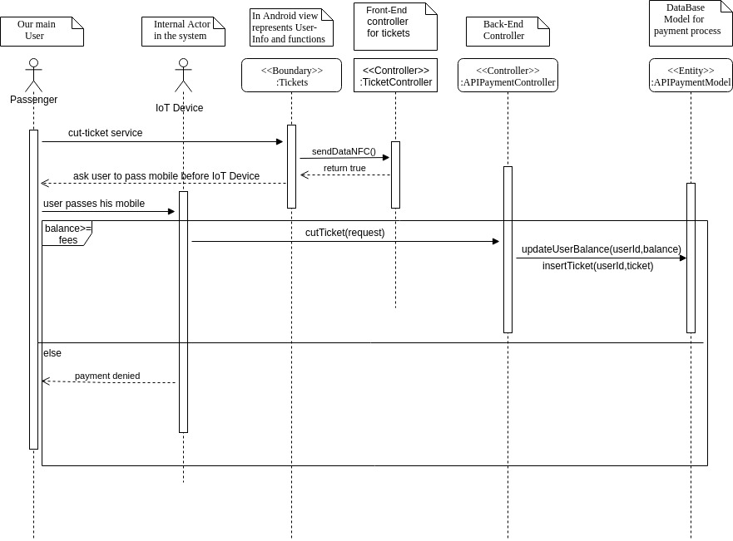
1. issueTicket:

Slide 19
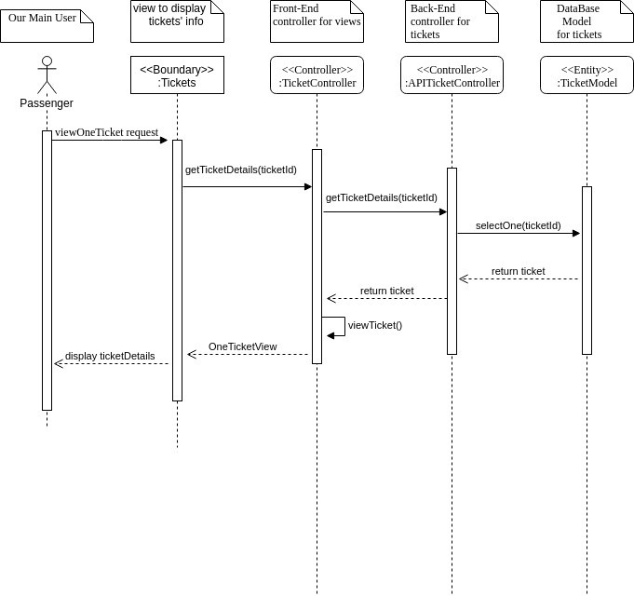
2. viewTicketDetails:

Slide 20
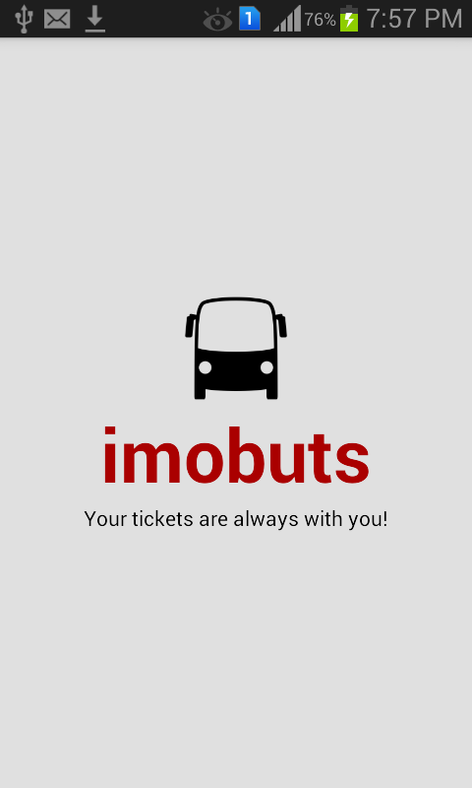
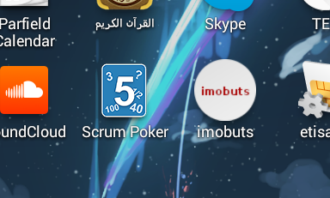
Application Prototype

Slide 21
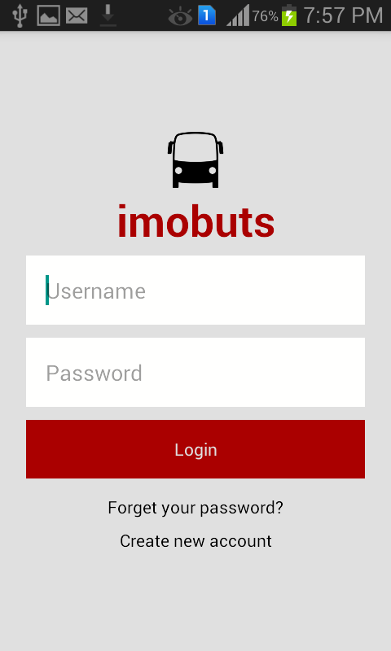
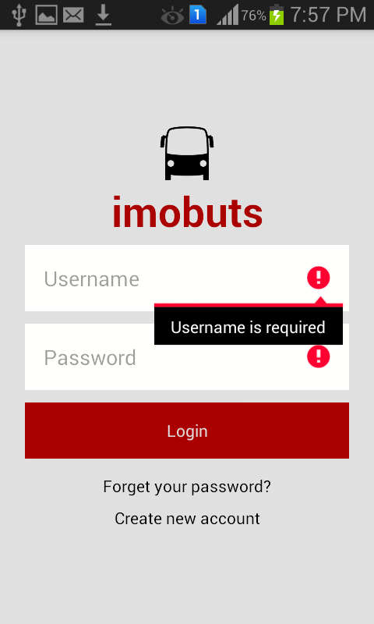
Application Prototype

Slide 22
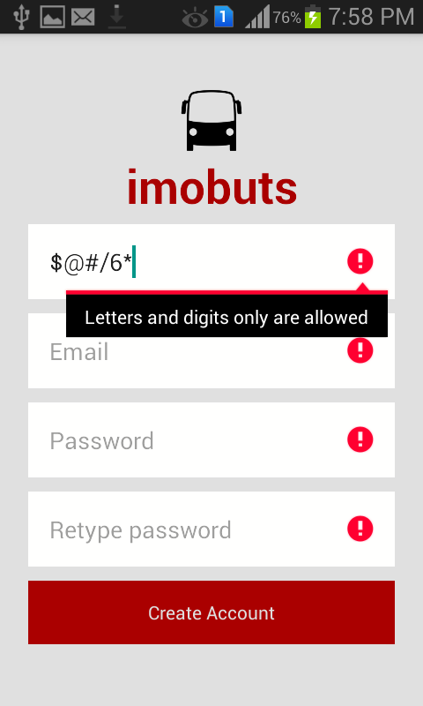
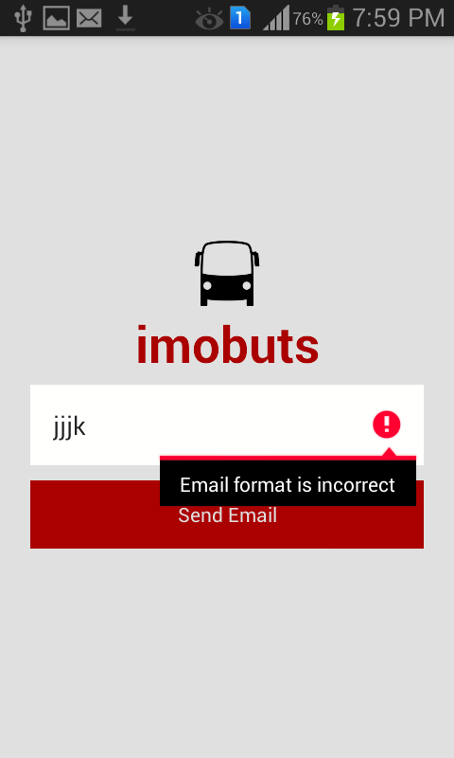
Application Prototype

Slide 23

Application Prototype

Slide 24
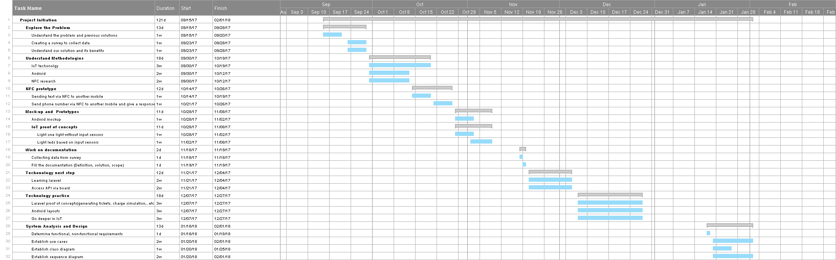
Time Plan
Previous 4 Months

Slide 25
Time Plan
Previous 4 Months

Slide 26
Time Plan
Previous 4 Months

Slide 27
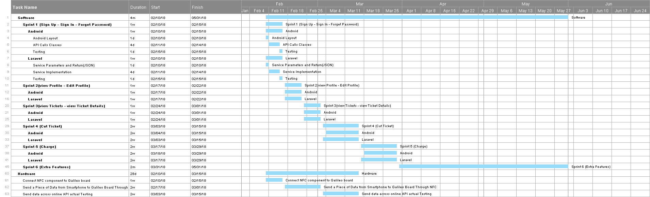
Time Plan
Next 4 Months

Slide 28
Time Plan
Next 4 Months

Slide 29
Time Plan
Next 4 Months

Slide 30
Conclusion
The point problems solved by such projects must not seem a life or death problems but not improving the system can lead to that in the future.

